Slide 1


Department of Electronics and communication Engineering
IOT BASED SECURITY SYSTEM USING ESP32 CAM AND YOLOv8 FOR INTRUDER DETECTION.
A REPORT SUBMITTED BY
1.NISHANTH M 611623106071
2.MUKESH M 611623106063
3.PRASANNA P 611623106079
4.PUGATHEESHWARAN 611623106082
SUPERVISOR
Mrs.V.ANNAPOORANI .,ME
ASSISTANT PROFESSOR
DEPARTMENT OF ELECTRONICS AND COMMUNICATION ENGINEERING

Slide 2

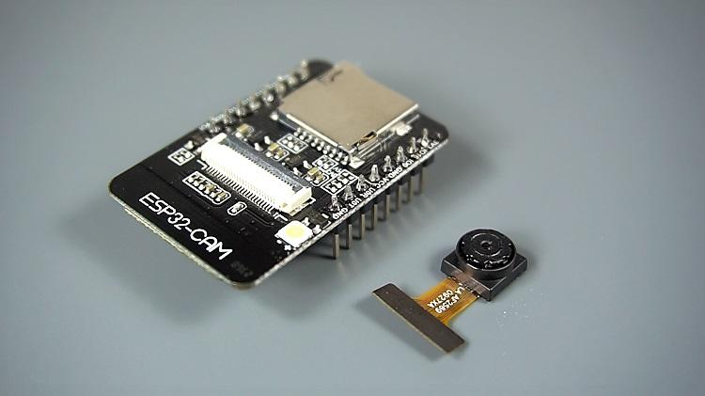
INTRODUCTION
Traditional CCTV systems rely heavily on human supervision - leading to fatigue and delayed response
YOLOv8 deep learning model enables real-time object detection with high accuracy
ESP32-CAM: Low-cost, compact microcontroller with integrated camera and WiFi
This project integrates cutting-edge AI with affordable IoT hardware for autonomous surveillance

Slide 3
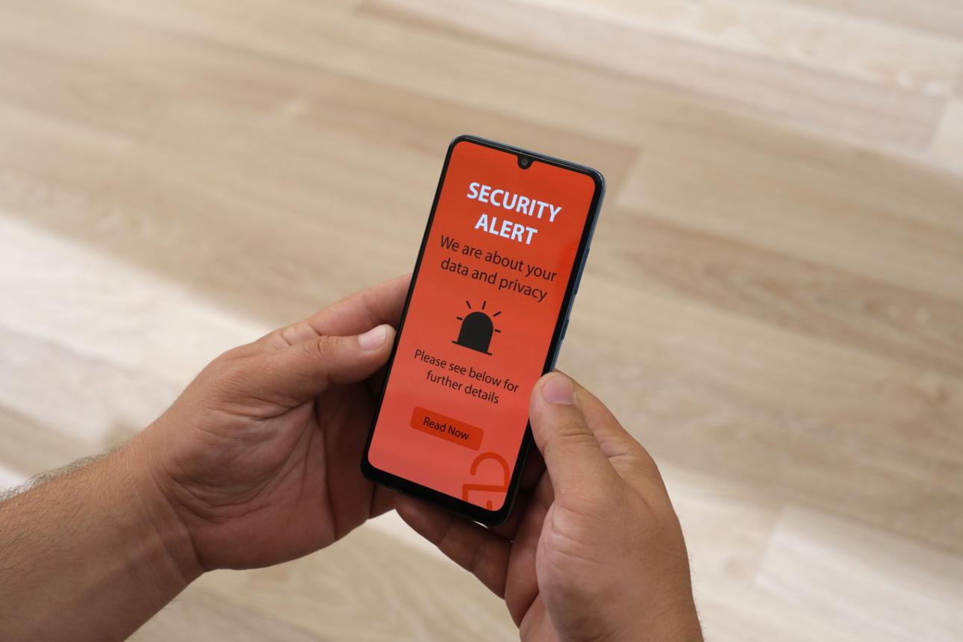

PROJECT OBJECTIVES
Design AI-powered intruder detection achieving >92% accuracy with <25ms latency
Implement distributed architecture: ESP32-CAM for capture + Server for YOLOv8 inference
Develop multi-channel alert system: Telegram, LED, Voice calls
Reduce false positives through adaptive thresholding & confidence scoring
Create modular, scalable architecture for future enhancements (facial recognition, multi-camera)

Slide 4
LITERATURE REVIEW
S.NO | AUTHOR & YEAR | METHODOLOGY | ADVANTAGES | LIMITATIONS
1 | Redmon et al. (2024) | YOLO real-time object detection using single-stage regression | High speed, real-time detection, global context understanding | Poor small object detection, localization issues
2 | Ultralytics (2023) | YOLOv8 with anchor-free detection and multi-scale features | High accuracy, faster inference, flexible deployment | Requires large datasets and high computational power
3 | Lin et al. (2023) | Deep learning with FPN and focal loss for pedestrian detection | Improved human detection, handles scale variations | Moderate speed, issues with occlusion and extreme conditions
4 | Hassan et al. (2020) | IoT-based surveillance using sensors and cloud computing | Remote monitoring, scalable system | High latency, depends on internet, lacks AI intelligence
5 | Shi et al. (2020) | Edge computing for local data processing | Low latency, faster response, reduced bandwidth usage | Limited processing power, complex architecture

Slide 5
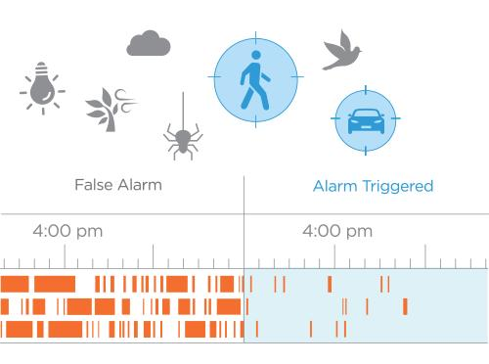
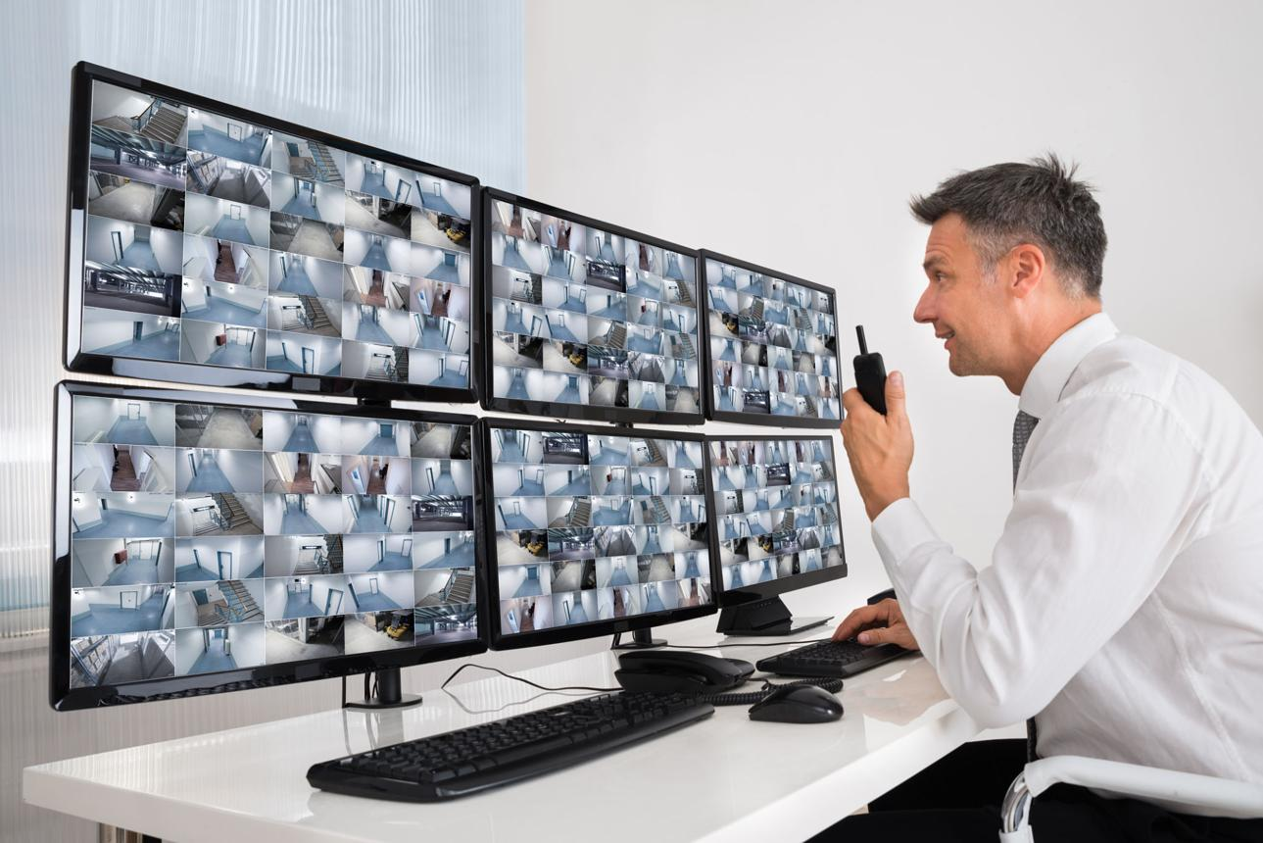
PROBLEM STATEMENT
Human Dependency: CCTV systems require continuous operator attention
High False Positives: Motion detection triggers excessive false alarms
Limited Coverage: Expensive to scale traditional infrastructure
Delayed Alerts: Incidents discovered only during post-incident investigation
High Maintenance: Complex backend infrastructure requires specialized expertise

Slide 6

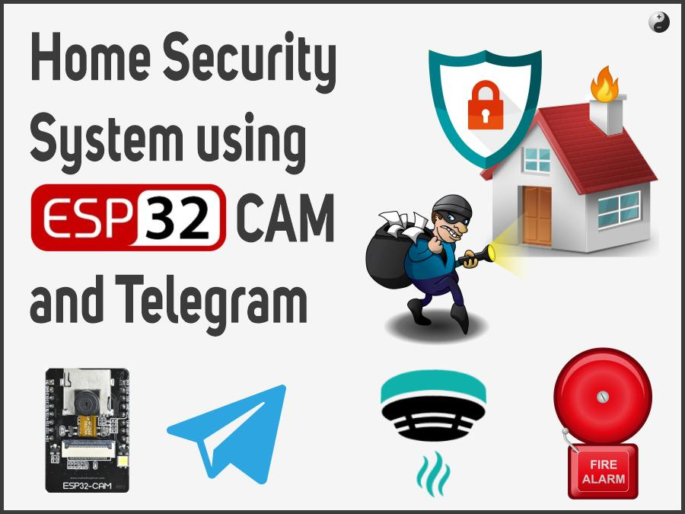
SYSTEM OVERVIEW
Hardware Layer: ESP32-CAM captures live video at configurable resolution
Communication: WiFi transmission (HTTP/MQTT) to processing unit
Processing: YOLOv8 deep learning model runs on Python-based server
Alert System: Multi-channel notifications via Telegram API, LED,Alert call.
Architecture: Distributed design separates data capture from computation

Slide 7
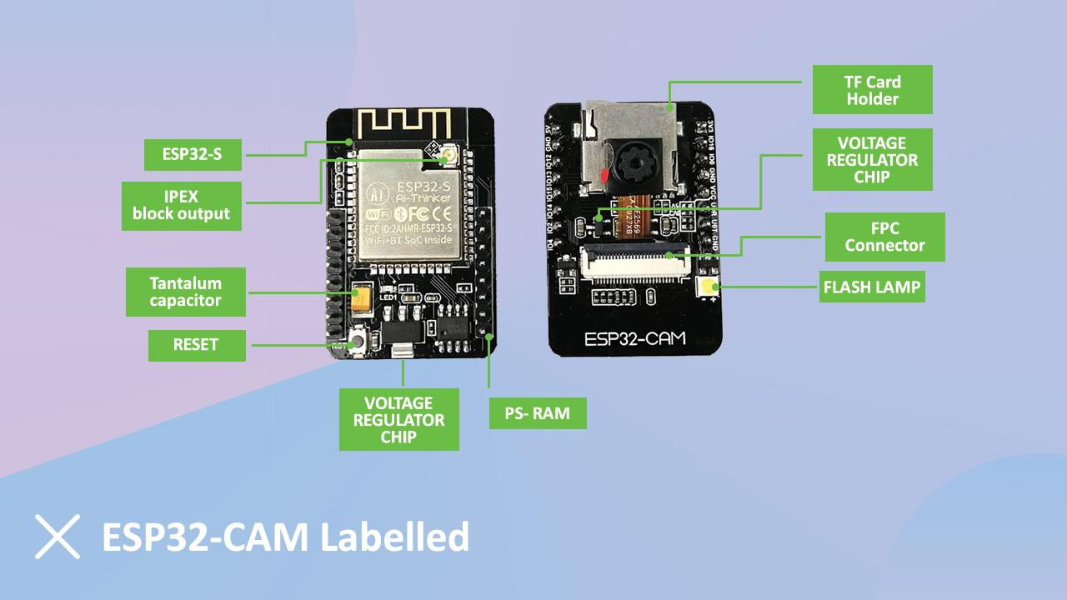
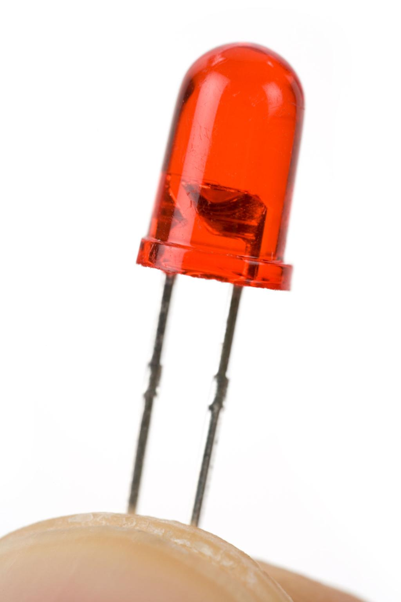
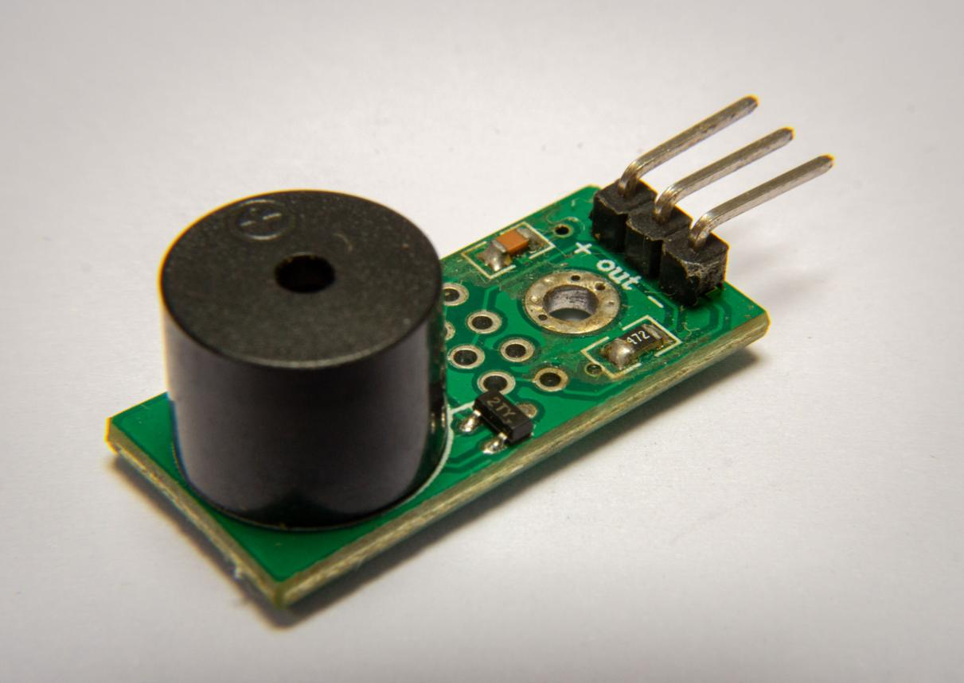
HARDWARE COMPONENTS
ESP32-CAM: Dual-core 240MHz processor, 2MP camera, 4MB flash, 3.3V operation
LED (Light Emitting Diode): Visual alert indicator connected to GPIO pins
Alert Call: An alert call will initiated if unkown is detected
Power Supply: Regulated 5V DC for stable operation
Communication: IEEE 802.11 b/g/n WiFi for wireless connectivity

Slide 8





SOFTWARE TECHNOLOGY STACK
Arduino IDE: Firmware development for ESP32-CAM initialization & image capture
Python: Main processing language with OpenCV, NumPy libraries
YOLOv8: Real-time object detection model for person detection
Telegram API: Cloud-based messaging for remote notifications
PyTorch: Deep learning framework for model inference

Slide 9
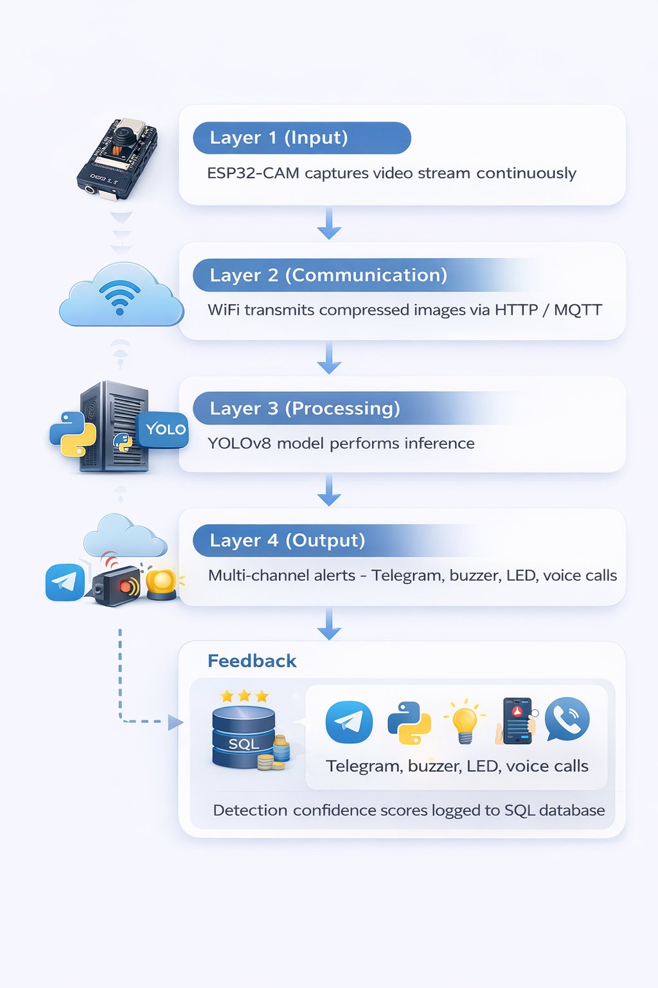
SYSTEM ARCHITECTURE
Layer 1 (Input): ESP32-CAM edge device captures video stream continuously
Layer 2 (Communication): WiFi transmission of compressed images via HTTP/MQTT protocol
Layer 3 (Processing): YOLOv8 model performs inference on Python server
Layer 4 (Output): Multi-channel alerts - Telegram, LED, voice calls
Feedback: Detection confidence scores logged to SQL database

Slide 10
WORKING PRINCIPLE
1 Initialization: ESP32-CAM powers ON, initializes camera, establishes WiFi
2️ Capture: Continuous image capture at regular intervals from monitored environment
3️ Transmission: Images sent to processing server via WiFi network
4️ Preprocessing: Images resized, normalized using OpenCV
5️ Detection: YOLOv8 analyzes frames for human presence with confidence thresholding
6️ Alert: If person detected (confidence > threshold) → Telegram + LED activation+Alert Call

Slide 11
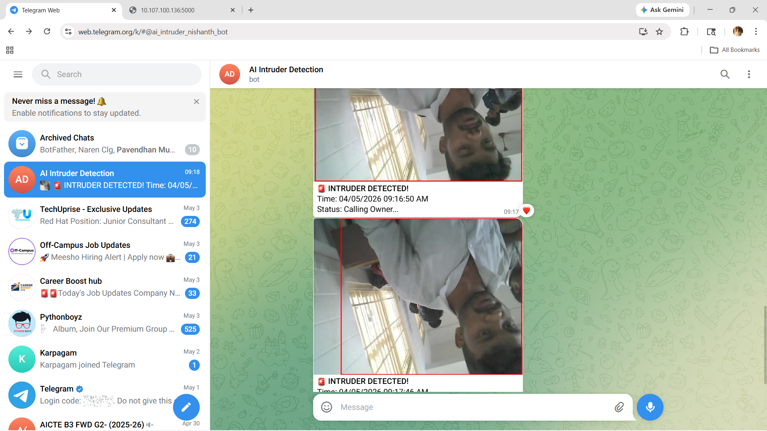

Slide 12
PERFORMANCE RESULTS
Detection Accuracy: 94.2% - Correctly identifies human presence in most scenarios
False Positive Rate: 3.8% - Minimal incorrect alerts due to adaptive thresholding
Frame Processing: 50-100ms per frame - Enables real-time performance (>25 FPS)
Telegram Alert Delivery& Alert Call : 99.3% success rate - Highly reliable remote notifications
End-to-End Latency: 1.5-2.5 seconds - Suitable for real-time security applications

Slide 13
KEY ADVANTAGES
Real-time Detection: YOLOv8 processes images instantly with minimal delay
High Accuracy: Smart human detection vs. basic motion sensing = fewer false alarms
Autonomous Operation: No human monitoring required - 24/7 automated surveillance
Multi-Channel Alerts: Telegram, LED, voice calls ensure 100% notification
Cost-Effective: ESP32-CAM (~₹1000) vs. traditional CCTV systems (₹50,000+)
Scalable: Modular architecture supports multi-camera deployments
\

Slide 14
CURRENT LIMITATIONS
️ WiFi Dependency: Network interruptions delay image transmission & alerts
️ Low-Light Performance: Reduced accuracy in night-time/dark environments (no IR)
️ No Face Recognition: Cannot differentiate between authorized & unauthorized persons
️ Processing Dependency: Requires external server - not fully edge-deployed
️ Environmental Sensitivity: Complex backgrounds/shadows cause occasional false positives
️ Power Requirements: Continuous power needed for both ESP32 and processing unit

Slide 15
FUTURE ENHANCEMENTS
Facial Recognition: Differentiate authorized vs. unauthorized individuals
Behavior Analysis: Detect suspicious activities, not just presence
Multi-Camera Coordination: Monitor larger areas with centralized processing
Mobile Application: User-friendly dashboard for remote monitoring & control
Cloud Integration: AWS/Azure for data storage, analytics, long-term logging
Edge Acceleration: Run optimized models on embedded devices to reduce latency

Slide 16
IMPLEMENTATION DETAILS
Arduino IDE: Firmware for ESP32-CAM with WiFi config & image capture logic
Python Server: Flask/FastAPI backend receiving images from edge device
YOLOv8 Setup: Pre-trained model on COCO dataset, optimized for 'person' class
Telegram Bot: API token integration for real-time alert notifications
Alert call: Twilio Python SDK
GPIO Control: LED triggered via microcontroller pins on detection
Testing: Validated across multiple environments (indoor, outdoor, varied lighting)

Slide 17
COMPARISON WITH TRADITIONAL SYSTEMS
Feature | Traditional CCTV | Motion Detection (PIR/Basic) | Our AI-Powered System
Technology Base | Manual monitoring | Basic infrared or pixel-change sensors | Edge-based Deep Learning & CV
Detection Logic | Human observation (active) | Simple physical movement | Semantic Human Presence Analysis
Infrastructure | High (Cabling, dedicated monitors, servers) | Moderate (Sensor networks) | Cost-Effective (Cloud/Edge integration)
Alert Accuracy | Variable (Human error/fatigue) | Low (Triggered by wind, light, pets) | High (94.2% Precision)
False Positive Rate | High (Due to manual oversight) | Very High (40–50%) | Ultra-Low (3.8%)
Response Time | Delayed (Post-incident review) | Immediate but often unreliable | Real-time Autonomous Alerts
Communication | Single-channel (Station monitor) | Basic Siren/Local Alarm | Multi-channel (App, SMS, API)

Slide 18
REAL-WORLD APPLICATIONS
Residential: Homes, apartments, gated communities for perimeter security
Commercial: Retail stores, offices, warehouses, shopping malls
Educational: Schools, colleges, universities for campus security
Critical Infrastructure: Banks, ATMs, power substations, telecom facilities
Healthcare: Hospitals, clinics for restricted area access control
Transportation: Railway stations, bus terminals, parking facilities

Slide 19
CONCLUSION
Successfully demonstrates feasibility of AI-based surveillance in resource-constrained environments
YOLOv8 + ESP32-CAM + IoT alerting = powerful yet affordable security solution
Achieves 94.2% accuracy with 1.8-sec latency - suitable for real-time applications
Multi-channel alerts ensure reliability - Telegram, LED, voice calls
₹10,000 total cost makes it accessible to small-medium enterprises & educational institutions
Modular design enables seamless scaling and future enhancements

Slide 20
THANK YOU
For your attention and feedback

